Slide 1
Introduction to Component-Based Software Engineering

Slide 2
Motivation
Expansion in the use of software
in business, industry, administration, research, and even in everyday life.
Software is no longer used marginally in technical systems; instead it has become a central factor in many fields.
Features based on software functionality, rather than other system characteristics, are becoming the most important factor in a competitive market.
This trend increases the demands on software products such as
enhanced usability, robustness, reliability, flexibility, adaptability, and simpler installation and deployment.
As these demands are growing stronger, the complexity of processes that software manages is increasing along with the demand for the integration of processes from different areas.
As a consequence, software programs are becoming increasingly large and complex.
The main challenge for software developers today is to cope with complexity and to adapt quickly to change.

Slide 3
Motivation
Traditionally, software development addressed the challenges of increasing complexity and dependence on external software by:
focusing on one system at a time
and on satisfying delivery deadline
and budget requirements without considering the evolutionary needs of the system.
Focusing on one system at a time and neglecting forthcoming changes has led to a number of problems:
the failure of the majority of projects to meet their deadline, budget, and quality requirements
as well as the continued increase in costs associated with software maintenance.

Slide 4
Motivation
One key to the solution of these problems is reusability.
The idea of software reuse is not new. But, despite some successes, reusability has not become a driving force in software development.
Many of the unsuccessful approaches to reuse did not satisfy the basic requirements of reusability
Reuse requires some modification of the object being reused.
Reuse must be integrated into specific software development.

Slide 5
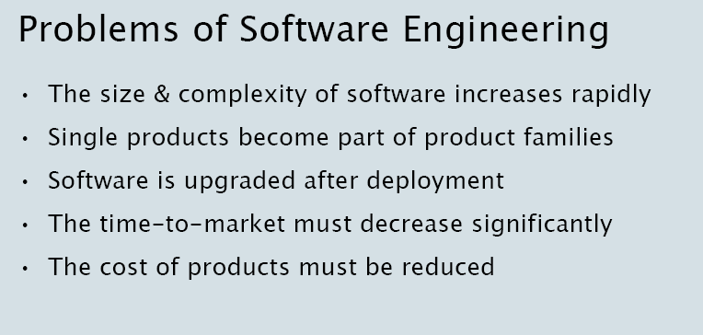
Challanges of Software Engineering

Slide 6
Component-based Development
❑ Idea:
Build software systems from pre-existing components (like building cars from existing components)
Building components that can be reused in different applications
Separate development of components from development of systems

Slide 7

Component-based software construction
components
Component
#1
construction
application
Component
#4
Component
#1
Component
#2
Component
#2
Component
#3
Component
#4
Component
#3

Slide 8
Concentration on the business parts
“30 % of SW development effort is spent on infrastructure that adds no value”
Application specific
Business issues
GUI
GUI
Standard Reusable parts
Communication
Data model
Deployment
- - - - - - INFRASTRUCTURE

Slide 9
What is software reuse?
Software reuse is the process whereby an organisation employs a set of systematic operating procedures to specify, produce, classify, retrieve, and adapt software artifacts for the purpose of using them in its development activities.

Slide 10
Reusable Assets
Virtually any product of the SE process can be reused:
Requirements
Architectures
Designs
design patterns, interfaces
Source Code
ranging from to libraries, patterns, to modules, to macros, coding conventions, ...
Test Scripts

Slide 11
CBSE Goals
To provide support for the development of systems as assemblies of components.
To support the development of components as reusable entities.
To facilitate the maintenance and upgrading of systems by customizing and replacing their components.

Slide 12

What is CBSE?
Component-based Software Engineering is concerned with the rapid assembly and maintenance of component-based systems, where
components and platforms have certified properties
these certified properties provide the basis for predicting properties of systems built from components.
Predictability is a key property of mature engineering disciplines. It enables feedback on design and adaptation;
i.e. development time is reduced because we can analyze prior to building

Slide 13

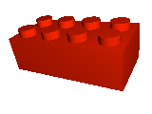

A component can be used within the scope of a component-model
.Net,
Enterprise Java Beans,
Corba Components + ...

Slide 14
On the relation between OO and CBD
Object Orientation emphasizes modularity of the construction of a system
CBD emphasizes modularity in design, production, deployment and use of a system.

Slide 15
Szyperski: Software Component Definition
Szyperski (Component Software beyond OO programming)
❑ A software component is
a unit of composition
with contractually specified interfaces
and explicit context dependencies only.
❑ A software component
can be deployed independently
it is subject to composition by third party.

Slide 16
Composition unit
A software component is a unit of composition with contractually specified interfaces and explicit context dependencies only. A software component can be deployed independently and is subject to composition by third party. –Clemens Szyperski
System
Glue code
Components
How much components fit together? How much costs the glue code?

Slide 17
Another definition
❑ A software component is a software element that
confirms a component model
can be independently deployed
composed without modification according to a composition standard.
❑ A component model defines specific interaction and composition standards.
G. Heineman, W. Councel, Component-based software engineering, putting the peaces together, Addoson Wesley, 2001

Slide 18
What is a Component?
A component is a piece of software small enough to create and maintain, big enough to deploy and support, and with standard interfaces for interoperability.
Jed Harris, President of CI Labs (Jan. 1995).

Slide 19
What is a Component?
- a unit of
independent production, acquisition, deployment, and maintenance
replacement
reuse
composition
properties depend
on how they are used
a package of cohesive services
encapsulates design decisions
explicit dependencies
cohesive / denotes a single abstraction
generic (application independent)
configurable
intrinsic properties
loosely coupled
standardized interfaces
self-contained
context / system properties

Slide 20
What is a Component?
“A binary unit of independent production, acquisition, and deployment that interacts to form a functioning system.”
C. Szyperski, Component Software
“A component is an independently deliverable package of operations.”
Texas Instruments Literature
“A replaceable unit of development work which encapsulates design decisions and which will be composed with other components as part of a larger unit.” - Desmond D’ Souza, in Catalysis

Slide 21
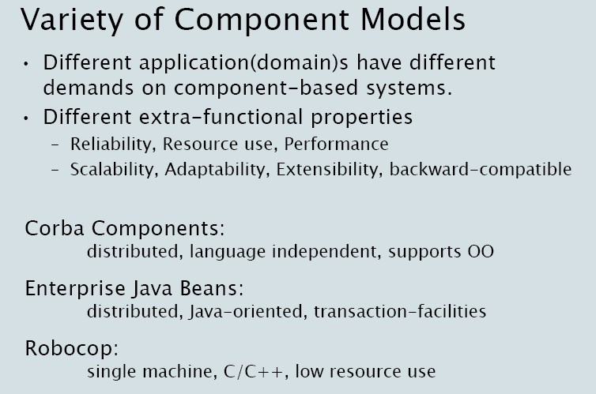

Slide 22
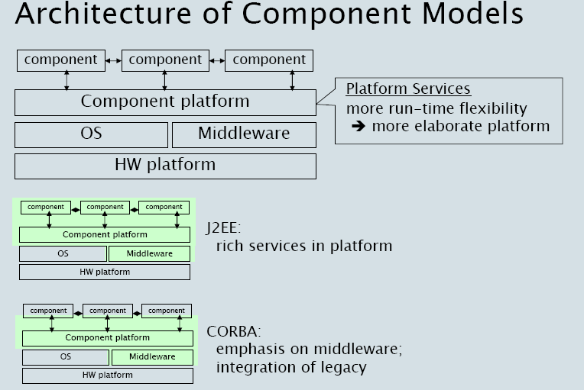

Slide 23



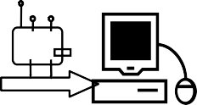



Component Development Lifecycle
phase
development
packaging
distribution
deployment
execution
representation of component
design & modelling tool
execution infrastructure
infrastructure
programming tool
compiler
packaging tool
configuration management tool
build/release tool

Slide 24




Component Development Lifecycle
phase development packaging distribution deployment
execution
representation of model / specification
component
e.g. UML, Petri-net
source code & data files
e.g. C++
Structured archive
e.g. zip-file
Solid-medium that preserves file-structure
network: requires conventions on where to install
unpack & place comp in memory executable code
low level machine code
high level code for interpretation
In different processes, components are composed
in different phases of development

Slide 25
Summary CBSE – basic definitions
❑ The basis is the Component
❑ Components can be assembled according to the rules specified by the component model
❑ Components are assembled through their
interfaces
❑ A Component Composition is the process of assembling components to form an assembly, a larger component or an application
❑ Component are performing in the context of a component framework
❑ All parts conform to the component model
❑ A component technology is a concrete implementation of a component model
c1
c2
Middleware
framework
Run-time system
Component Model

